Slide 1

High School Transition Night
School of the Arts
Information Session
May 19, 2025
6:00 PM - 7:00 PM

Slide 2


Introductions
Heather Kelly - 7th-9th Grade Counselor A-L
Nadia Adams - 7th-9th Grade Counselor M-Z

Slide 3

Expectations
  Be Punctual and Be Present
    Attendance in high school is critical and directly related to the passing or failing of courses.
      Ex. Labs require a set amount of lab minutes to take a regents exam. When a student doesn't have enough minutes, they cannot sit for the exam. Communicating and advocating for oneself
  Emailing or speaking with teachers when there is a question or need help
    Setting up appointments with school personnel
    Checking PowerSchool regularly to ensure they are aware of work that is due, or if anything is missing.
    Parents are also able to access PowerSchool - if you need the ID and Password, please let us know so we can send it to you!

Slide 4

Expectations
  Students and Parents should be aware of RCSD and SOTA codes of conduct
  Students should maintain:
    Self-control
    Appreciation of the rights of others
    Respect for the property of the school and others
    Appropriate use of social media
    Display compliance with classroom rules for each individual teacher

Slide 5

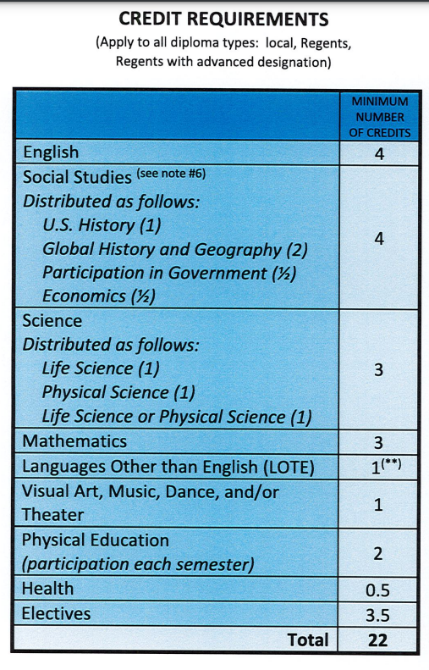
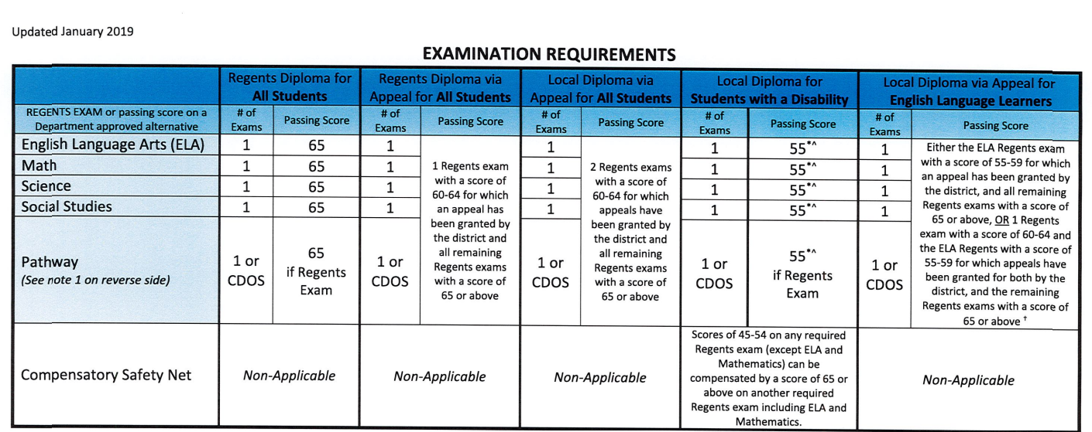
NYS Graduation Requirements

Slide 6
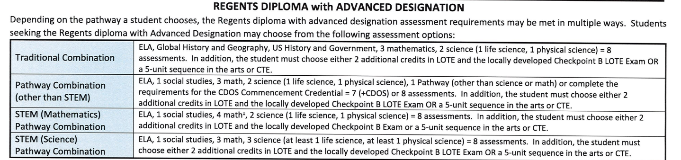

NYS Requirements
SOTA Students already qualify for the NYS Advanced Designation with the Arts credits earned through their major.

Slide 7


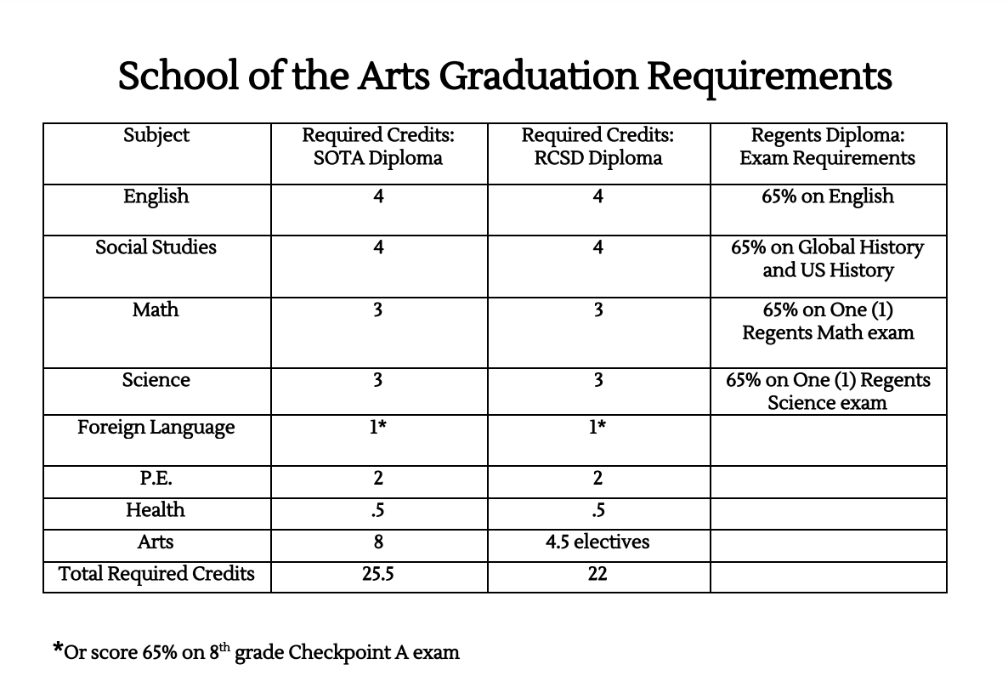
SOTA Graduation Requirements

Slide 8

School Links and College Board
SchoolLinks:
  Where Counselors can communicate with parents, students, and college programs.
  Where students can connect with colleges and learn more about their academic, social, and emotional needs and goals.
College Board:
  A non-profit organization that supports college transitions and is the hub to see test scores such as the SAT, ACT, and AP exams.
  College Board also offers tutoring programs based on PSAT results
  For more information, you can visit the College Board website: https://www.collegeboard.org/

Slide 9
Summer School
8th-grade students going into 9th grade have an opportunity for advancement as well as recovery this summer:
  Acceleration University at St. John Fisher University: This placement is for advancement for high school credits. Parents must sign their child up if they’d like to attend.
  For students currently enrolled in a credit-bearing course, such as Earth Science or Algebra I, who fail an exam or course will be registered by their counselor for recovery at summer school.

Slide 10

What to Expect in July
Course requests will be sent out at some point in July. If there is something that is incorrect or needs changing, please contact Mr. Tirre via e-mail.

Slide 11



Contact Information
Nadia Adams: nadia.adams@rcsdk12.org (585) 242-7682 X 4253
Heather Kelly
heather.kelly@rcsdk12.org
(585) 242-7682 x 4320

Slide 12

Q & A

Slide 13
Questions:
Q: Do students need to take summer school to take the August regents? Can they take the exam without taking summer school?
A: You do not need to attend all of the summer school if you pass the class but fail the regents. There is an opportunity to take a review class if you opt out of school in this case. If you fail the class and the regents, you should be signed up for summer school.
Q: What is the minimum grade for AP classes?
A: Students must have a 65 or higher to pass a course. The AP exam is on a 1-5 rating scale. Colleges recognize a 3, 4, or 5 for college credit. Some colleges only recognize a 4 or 5.
Q: If my student is taking Earth Science and Algebra I in 8th grade, does it count towards their diploma?
A: YES!! These classes, along with Spanish I C count towards a student's high school diploma (One credit for each class)

Slide 14
Questions
Q: What is the Spanish Checkpoint A exam?
A: This is the exam that 8th-grade students take to gain credit toward their language requirement for graduation.
Q: What are the other languages offered at SOTA?
A: After a student completes Spanish I C, they can take Mandarin Chinese or American Sign Language which are offered as a virtual course and taken in the Virtual lab with teachers in the room to help them if they need support.
Q: If my child plays a sport, are they PE exempt?
A: We do not exempt students who are athletes from PE. However, we do offer Dance classes for non-majors that count as a PE credit. Students have a choice between Jazz and Tap PE.

Slide 15
Questions
Q: What do students do when they have completed their 3 Math and 3 Science credits?
A: They can take more elective classes, continue on with other Math and Science classes, or they can have an advisement period.
Q: How does a student obtain an Advanced Regents Diploma with Honors?
A: The student must score above a 90% on each regents exam.
Q: Can a student take Mandarin Chinese in the World Language track?
A: There are no regents exams for Mandarin Chinese but it still counts for high school credit.

Slide 16
Questions
Q: How does the course request process work?
A: Students fill out a form during the year with their preferences and those preferences are taken into consideration when the counselors are inputting the information. SOTA has a very specific track that needs to be followed with major classes involved, but students or parents are able to see their requests via PowerSchool and can email their counselor or principal if there needs to be a change.
Q: When will students find out about their acceptance to the St. John Fisher Summer Program?
A: Families will be notified before the end of June. They will hear from the district or their counselor directly.

Slide 17
Questions
Q: How do students double major?
A: Students have to re-audition in January to have a major added to their program of study. The addition of another major would not happen until the following year if accepted (Auditioned in 9th and begins in 10th). If a student re-auditions, they do not lose their spot in their current major. When a student "double majors" they take two pathways but they only complete half of each.

